Slide 1
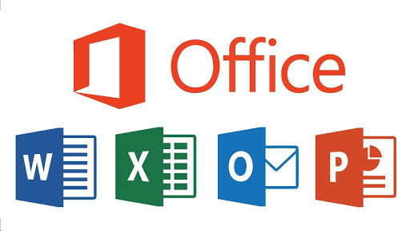
Introduction To Microsoft Office
Microsoft Office is a software suite of productivity applications including Word for word processing, Excel for spreadsheets and data analysis, and PowerPoint for presentations. It also offers other tools like Access for databases, Outlook for email, and OneNote for note-taking, all designed to automate manual office tasks and boost productivity. The suite is available as a desktop application and through cloud-based services like Microsoft 365, allowing users to create, edit, and share documents, spreadsheets, and presentation

Slide 2
Introduction To Microsoft Office
Microsoft Office was introduced by Bill Gates, who first announced the software suite on August 1, 1988. At the time, the initial version included Microsoft Word, Microsoft Excel, and Microsoft PowerPoint.
developed by Microsoft Corporation for productivity, which includes programs like Word, Excel, and PowerPoint. Microsoft is a multinational technology company known for its software, hardware, and cloud services, with Office being one of its most prominent product suites.

Slide 3
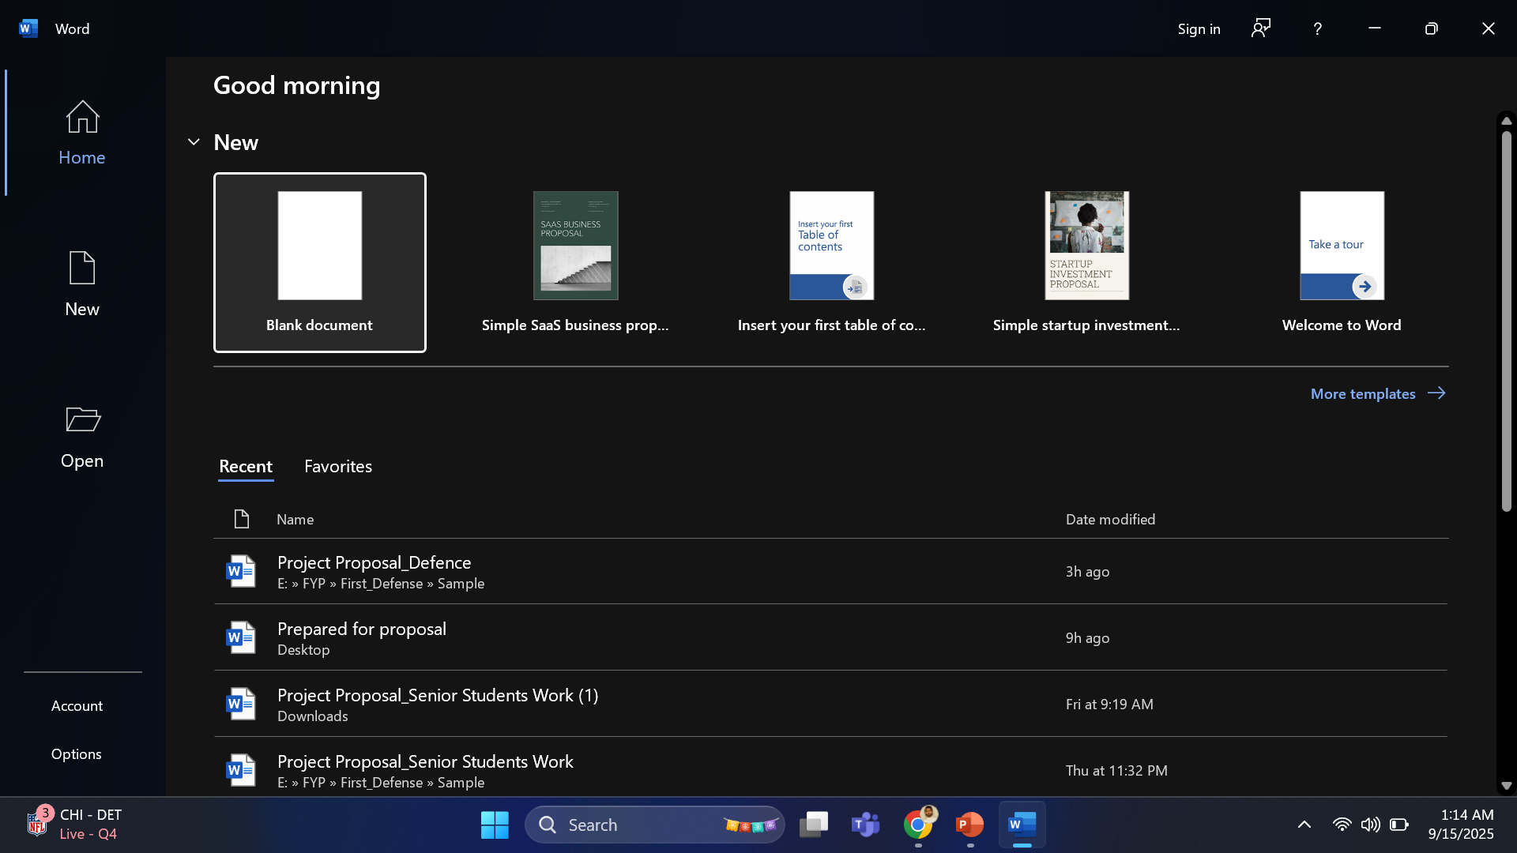
Tabs in MS Word.
A tab is like a section in MS Word where similar tools are grouped together.
Example: Think of tabs as headings in a book. Each heading contains related topics (tools).
Common Tabs
Home Tab
Contains basic tools for writing and editing text.
Example: font size, bold, italic, underline, copy, paste.
New Tab—have also search option
Used when you want to create a new blank document.
Example: If you are done with one page and want a fresh page, you click New.
Open Tab
Used to open an existing file that you already saved before.
Example: Yesterday you wrote an essay, today you want to open it → you use Open.

Slide 4
Templates in MS Word.
Templates in MS Word
A template is like a ready-made design or format that you can use instead of starting from scratch.
It already has a structure, style, and layout prepared for you.
You just replace the sample text with your own content.
Examples:
Resume Template → A CV design is ready; you only type your name, skills, and experience.
Invoice Template → Billing format is ready; you just fill in customer details and prices.
Letter Template → Proper letter structure is already there; you just change the text.

Slide 5
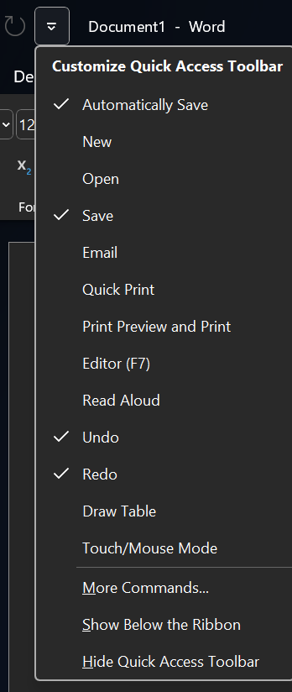
Black Document
Title Bar(Document1)
Quick Acces Tool Bar (we add those things which we regularly use

Slide 6
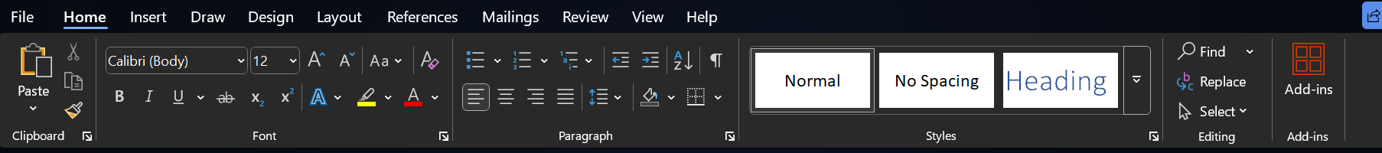
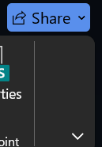
Ribbion.
Ribbion HidePress Ctrl + F1 → This quickly hides or shows the Ribbon.
Or Click The Arrow Blow the Share Option and then for showing ribbion click on the (View Option)

Slide 7
Tabs.
A Tab is like a category or section at the top of MS Word.
Each tab contains related tools inside it.
Examples from your picture:
Home Tab → tools for writing (font, size, bold, copy, paste).
Insert Tab → tools for adding things (pictures, tables, charts).
Design Tab → tools for changing the look (themes, colors, styles).
View Tab → tools for how you see the document (zoom, focus mode, ruler)

Slide 8
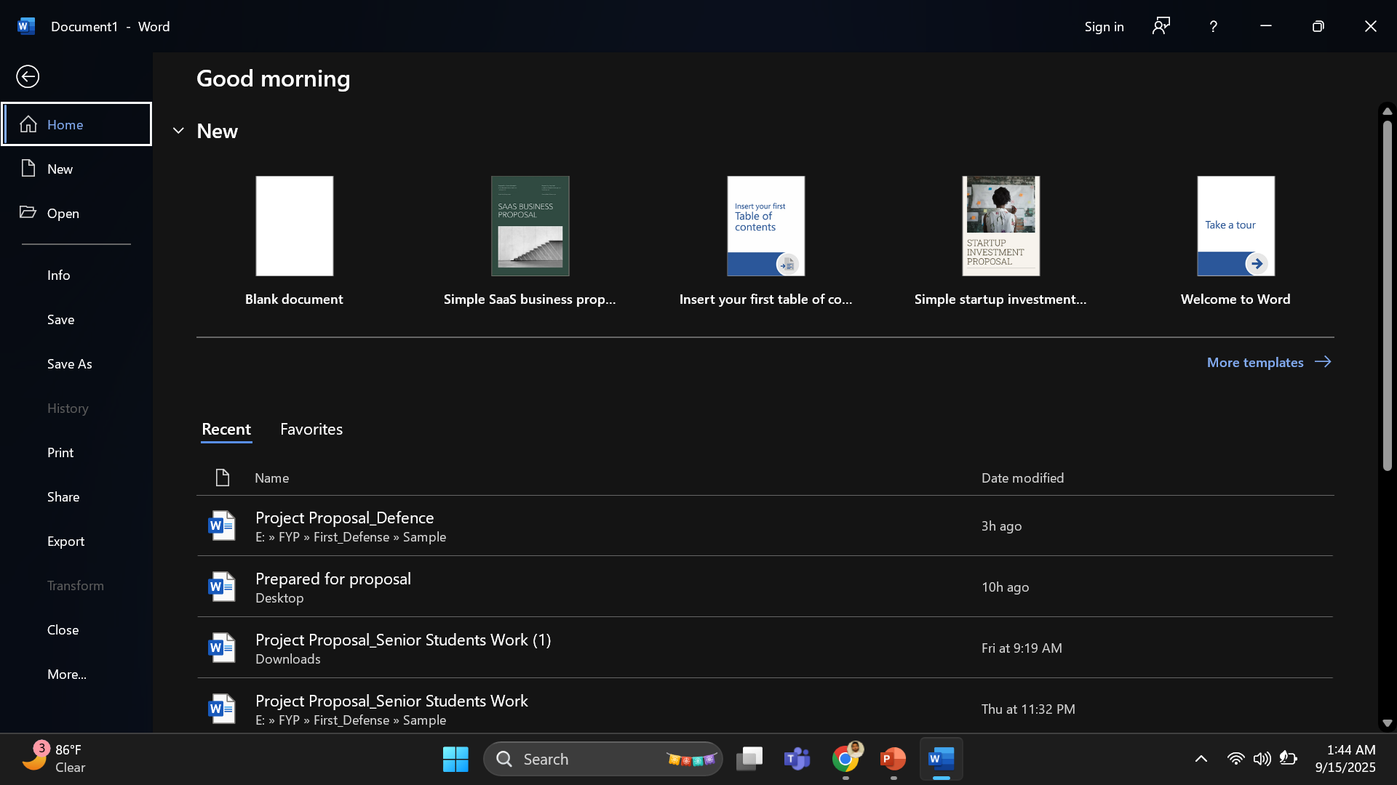
Tabs.
File Tab (Save)

Slide 9
Status Bar
The status bar is the bottom strip of MS Word (at the bottom of your screen).
It shows important information about your document.
Examples of what you see on the status bar:
Page number → e.g., Page 1 of 5
Word count → e.g., 120 words
Language → English (US)
Zoom level → 100% (you can zoom in/out from here)
View buttons → Print Layout, Web Layout, Read Mode

